Slide 1
Review of the Literature and Citations Session 03
Course : COMP6575 – Research Topics in Computer Science
Effective Period : December 2019

Slide 2
Learning Outcomes
At the end of this session, students will be able to:
LO 1: Describe the basics of writing research paper and the research lifecycle
LO 2: Select the research topic, literature and writing strategies used in the project

Slide 3
Outline
They Why?
Purpose
Steps in conducting a literature review
Resources
Table of comparison
Citations
5 Goals of Citations
Other Problems with Citations

Slide 4
Why do we need literature review?

Slide 5
The WHY?
Literature review helps to determine whether the topic is worth studying
it provides insight into ways in which the researcher can limit the scope to a needed area of inquiry
It shares with the reader the results of other studies that are closely related to the one being undertaken
Literature sections in proposal are generally shaped from the larger problem to the narrower issue that leads directly into the methods of a study

Slide 6
The purpose
In general, the literature review can take several forms. Cooper (2010) discussed 4 types : Literature reviews that
Integrate what others have done and said
Criticize previous scholarly works
Build bridges between related topics
Identify the central issues in a field

Slide 7
Steps in Conducting a Literature Review
A literature review means locating and summarizing the studies about a topic.
There is no single way to conduct a literature review, but many scholars proceed in a systematic fashion to capture, evaluate, and summarize the literature:
Begin by identifying key words, which is useful in locating material in an academic library at college or university.
With these key words in mind, go next to library and begin searching the catalog for holdings.
Initially try to locate about 50 reports of research in articles or books related to research on your topic.
Skip the initial group of articles or chapters, and duplicate those that are central to your topic.
As you identify useful literature, begin designing a literature map.
Draft summaries of the most relevant
After summarizing the literature, assemble and structuring it thematically or organizing it by important concepts

Slide 8
Resources
Some journals and proceedings papers are not available free to the public.
There is a social network called Research Gate. You could register there, some researchers uploads their works there.
You could also try Google Scholar to find your references topic.

Slide 9
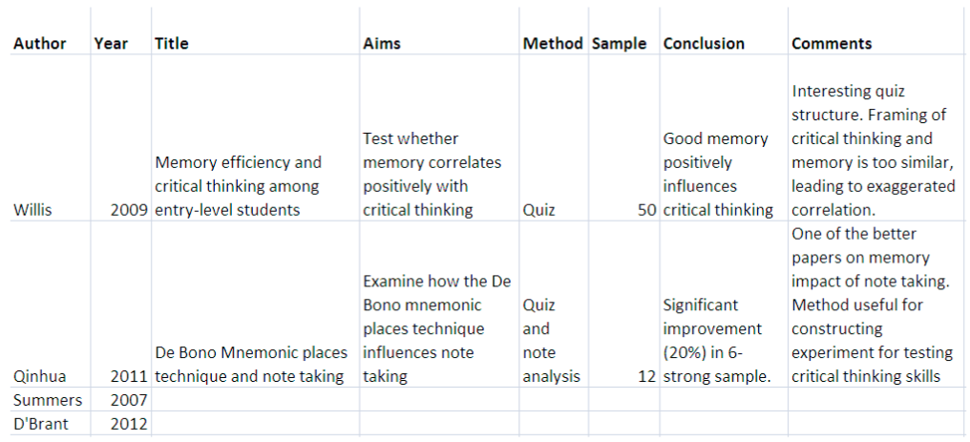
Table of comparison
Another way of managing sources and arguments presented in them is to use a literature review matrix (also called synthesis matrix). Literature review matrix is a table in which you can represent the views, ideas, or data according to thematic categories that correspond to your research project.

Slide 10
Citations

Slide 11
Citations
Is a reference to a source of information or data
Things that can be cited journal articles, conference proceedings, books, student theses, newspapers, non-print sources (such as film or other recorded media), websites or other online resources, computer materials and personal communications.
The citation should be located in the text in such a way that it is clear what material requires the citation
Often, this is at the end of a sentence, but sometimes it must be put in the middle of the sentence to enhance clarity

Slide 12
The 5 Goals of Citations
Provide sufficient context of the work to allow for critical analysis of the work by others and thus to enable the readers to gauge themselves whether the author’s conclusions are justified
Give the reader sources of background and related material so that the current work can be understood by the target audience (thus creating a web of science)
Establish credibility with the reader (e.g., the authors knows the field, have done their homework, etc.) and/or inform the reader that the paper belongs within a specific school of thought;
Provide examples of alternate ideas, data, or conclusions to compare and contrast with this work
Acknowledge and give credit to sources relied upon for this work (i.e., acknowledge the use of another’s ideas or data), thus upholding intellectual honesty.

Slide 13
Verify, Verify, Verify
One of the most pervasive problems with citations is that they are frequently incomplete or inaccurate
It is the job of the authors to verify the accuracy of the references
For to few authors take this advice seriously. Several studies found that between 34% - 67% of references in a variety of medical and biomedical journals contains errors (Major and Minor errors)
Major error
the article could not be found given the information in the citation
Minor error
it include punctuations or spelling mistakes, mistakes in the article titles, mistakes in the name and initials of the author(s), and citation style mistakes. These errors serve as irritants to the reader—they can still find the article, but they have to put more effort into it

Slide 14
Other Problems with Citations
Spurious citation
Citations that are not needed but are included anyway
Biased citations
Biases include overciting of friends’ or colleagues’ work, omitting cites to the work of rivals, and gratuitous citations in an attempt to curry favor with a boss or potential referee
Self-cites
There is nothing wrong with self citations. Knowing as we do the tendencies of many scientists toward self-promotion, one fears that self-cites may be designed to boost the recognition of the author rather than increase the value of the paper to the reader
Excluding contrary evidence
a form of biased citations where citations to prior work whose conclusions or data contradict the current work are omitted

Slide 15
References
John W. Creswell. (2017). Qualitative, Quantitative, and Mixed Methods Approaches Research Design:5th edition. SAGE Publications, Inc. ISBN: 978-1-5063-8671-3
Chris A. Mack. (2018). How to Write a Good Scientific Paper. Society of Photo-Optical Instrumentation Engineers (SPIE). ISBN: 978-1-5106-1913-5
https://www.monash.edu/rlo/graduate-research-writing/write-the-thesis/introduction-literature-reviews
https://writing.wisc.edu/handbook/assignments/reviewofliterature/
https://writing.wisc.edu/wp-content/uploads/sites/535/2018/08/Lit-Review-Moore-NSF-1.pdf

Slide 16
In Class Assignment

Slide 17
Please find at least 10 research papers and do the table of comparison!

Slide 18
Thank you

